Slide 1
enlighten us, but make it quick!

Slide 2
Enlighten us, but make it quick!
presentation
performance
passion

Slide 3
Began 2006
Events globally
2014 … part of New Brunswick Student “Oratory” competition
(oratory, debate, slam poetry)

Slide 4
What is...
Fast-paced, passion fueled:
5 minutes
20 slides
15 seconds each (pre-timed)

Slide 5
How to...
Choose something…
You love / excites you
You hate / makes you angry
You are good at

Slide 6
Avoid lots of text!
Your audience will begin reading your slides the second they appear and this will distract them from the topic you’re sharing, plus you won’t end up in BIG trouble from practicing Death By PowerPoint

Slide 7
Less…
Text
Bullets
Sentences

Slide 8
One idea per slide!

Slide 9
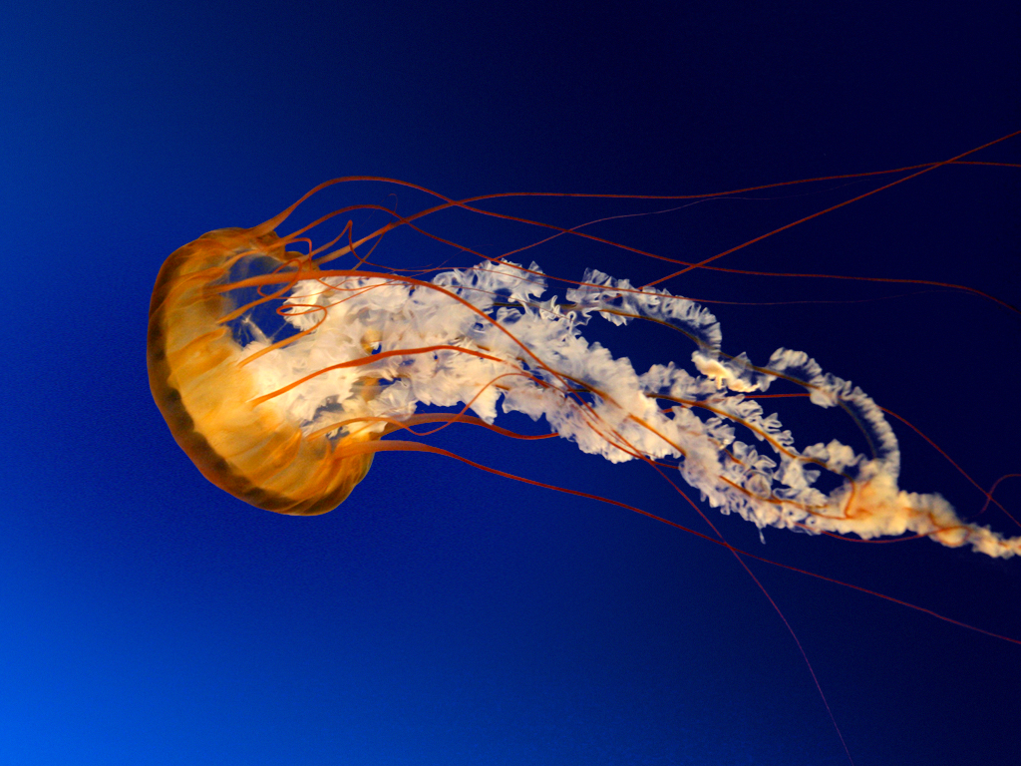
A picture is worth 1,000 words!

Slide 10
Images
search.
.org

Slide 11
Resource
PresentationZen.com

Slide 12
Rehearse
Rehearse
Rehearse

Slide 13
Rehearse
Recovering
Improv Editing
Focus on Key Ideas
Without Notes

Slide 14
More reading?
Ignite Show: Scott Berkun - "Why and How to Give an Ignite Talk", Ep 19.
http://scottberkun.com/2009/how-to-give-a-great-ignite-talk/
http://www.arikhanson.com/2011/05/02/5-tips-to-a-killer-ignite-presentation/

Slide 20
Enlighten us, but make it quick!

