Slide 1
Calibrating Standards in the Assessment of Recitals

Slide 2
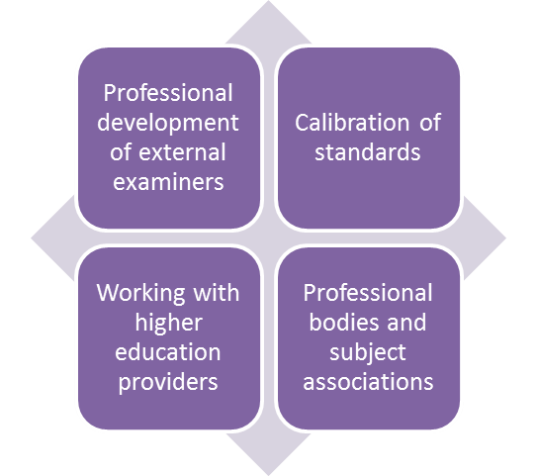
Introduction
This event is based on a successful calibration event run by the HEA and Conservatoires UK in 2018.
We are grateful to RNCM for hosting that event and providing the student examples.
It will be a workshop of viewing and debating a range of recital performances.
Chatham House rule applies.
Notes:
Present the text as on the slide.
Boxes on right illustrate the various components of the HEA (now Advance UK) Degree Standards Project aimed at further professionalising external examiners.
Chatham house rule : Take away any ideas and learning you gain from the event but do not share any information about individuals or institutions that you acquired in the process.

Slide 3
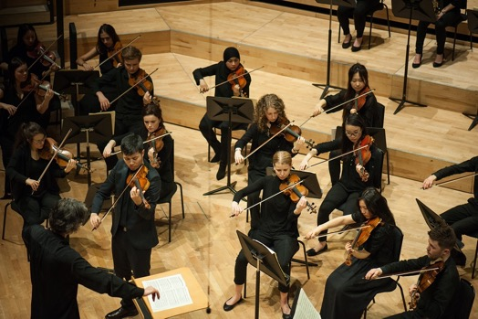
Intended outcomes
Participants will develop:
greater awareness of differences in academic standards across assessors
greater capability and confidence in drawing on accepted academic standards in their assessing and external examiner roles
a shared interpretation of agreed key criteria for the assessment of recitals, with reference to relevant national standards statements.
Notes:
Briefly introduce these learning outcomes for the workshop

Slide 4
Why calibration?
View the video explaining ‘Why Calibration?’
[link to video]
This video was recorded at a calibration workshop organised by Conservatoires UK and the Higher Education Academy, hosted by the Royal Northern College of Music on 27 February 2018.
Notes:
Notes: The video records the presentation on ‘Why Calibration’ as presented to the Conservatoire UK Calibration event held in Feb 2018.

Slide 5
Social moderation to calibration
Moderation is generally focused on agreeing marks, as in a panel discussion of a student performance.
Calibration is about shared knowledge of standards, often achieved through social moderation processes in order to create ‘calibrated’ academics.
‘calibrated’ academics … are able to make grading judgements consistent with those which similarly calibrated colleagues would make, but without constant engagement in moderation. The overall aims are to achieve comparability of standards across institutions and stability of standards over time (Sadler, 2012)
Notes:
Social moderation (also known as ‘consensus’ moderation) is a process for obtaining consistency in understanding and applying academic standards based on discussion of concrete examples and drawing on relevant reference points such as assessment criteria, learning outcomes or grade descriptors. A typical panel constituted to judge student recitals is an example of social moderation in practice.
However, moderation activities are generally focused on agreeing marks for an assignment but external examiners need to bring their standards to the judgement of a whole range of new and varied student assignments, examinations and performances. This is where the concept of calibration becomes important. This calibration event is aimed at improving the consistency of marking recitals and is an example of using a social moderation method to assist assessors and examiners in making similar judgements.
The aim of Calibration is to create an assessor who can independently make similar judgements on new and different pieces of work. In the academic world, we are exploring the use of social moderation processes to develop the ‘calibrated academic’ (Sadler).

Slide 6
The calibration process
STAGE 1 – Individual (in advance of workshop)
Watch each performance and mark it.
Marks and comments are entered anonymously online.
Comments focus on the aspects of the performance which most influenced the mark.
STAGE 2 – Panel
Share your marks and comments in your panel.
Discuss your views and try to arrive at a consensus regarding the mark.
Enter on the ‘panel’ sheet your agreed mark and the characteristics of the performance that most influenced your decision particularly at the borderlines – pass/fail, 2.2./2.1, 2.1/1.
STAGE 3 – Whole group
We will share the panel judgements and try to achieve a consensus across the room – making the case for our viewpoints where they differ.
We will try to assemble a list of the common characteristics of the performance which influenced our judgement – i.e. making explicit as possible our standards.
Notes:
Notes: Present as text on slide.
NB, Stage 1 may have been done independently by delegates before attending the workshop.

Slide 7
Recital 1: Piano
Insert details of the results entered online.
Range of marks
Average mark
Mode (middle mark)
Notes:
Notes: Insert data as requested on slide if available.

Slide 8
Recital 2: Popular music
Insert details of the results entered online.
Range of marks
Average mark
Mode (middle mark)
Notes:
Notes: Insert data as requested on slide if available.

Slide 9
Recital 3: Horn
Insert details of the results entered online.
Range of marks
Average mark
Mode (middle mark)
Notes:
Notes: Insert data as requested on slide if available.

Slide 10
Recital 4: Cello programme
Insert details of the results entered online.
Range of marks
Average mark
Mode (middle mark)
Notes:
Notes: Insert data as requested on slide if available.

