Slide 1
Calibrating Academic Standards in Geography

Slide 2
Aims
To raise awareness among geography academics and examiners of the potential variation in academic standards across different assessors
To use dialogue to build greater consistency in the judgement of student work among geography lecturers and examiners, within and across programmes and institutions
To discuss and create a shared understanding of criteria for the assessment of research-based coursework essays or reports, drawing on key reference documents
Notes:
Notes: Briefly introduce the aims for the workshop – note that the specific learning outcomes are on the next slide.

Slide 3
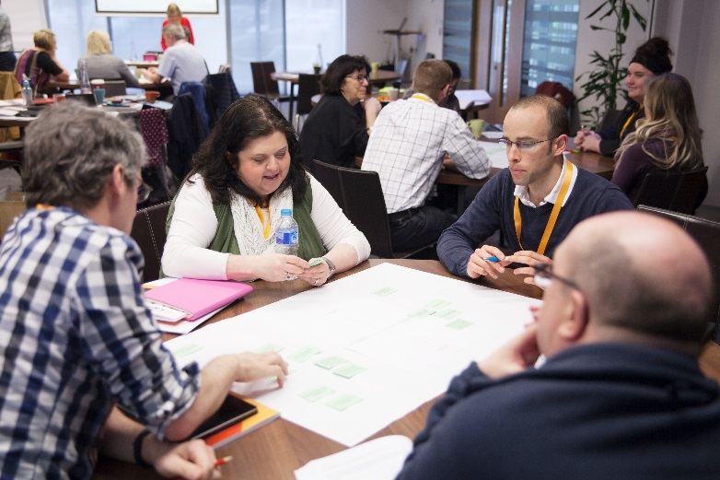
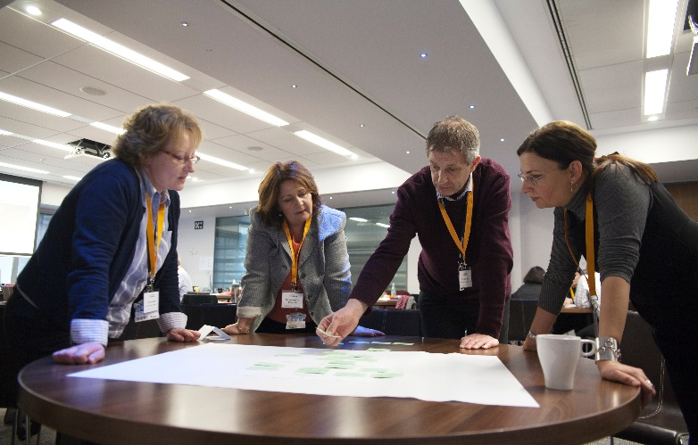
Intended outcomes
Participants will develop:
greater awareness of differences in academic standards across assessors
greater capability and confidence in drawing on accepted academic standards in their assessing and examining roles
a shared interpretation of agreed key criteria for the assessment of research-based coursework essays or reports, with reference to relevant national standards statements.
Notes:
Notes: Briefly go through the learning outcomes for the workshop

Slide 4
Format of the day
Introduction
Brief presentation of research on consistency and patterns of marking in higher education in general, and geography in particular
Calibrating our standards through attempting to achieve a consensus about the coursework examples – in small groups and then across the whole group
Developing a list of influential characteristics in student work that help to decide marks, particularly at the borderline
Adhering to the Chatham House rule
Notes:
Notes: Use this slide to outline the programme for the day

Slide 5
Policy context
‘it would be beneficial to the sector and its stakeholders to consider further modernising or professionalising the external examining system. We believe that further strengthening some aspects of the current arrangements would enhance the role of the … system as part of the future quality assessment system’
(HEFCE, 2016: Revised Operating Model for Quality Assessment p. 36)
Advance HE were awarded the contract by OfS on behalf of the devolved administrations to lead the Degree Standards project, running from 2016 to 2021.
The project, which is sector-led, aims to develop a sector-owned process of professional development for external examiners.
Notes:
Notes: Use this slide to briefly explain that this project has emerged out of the Review of Quality Arrangements (2015) by HEFCE as stated in the Revised Operating model for quality published in 2016.
Note that Quality arrangements, specifically the Quality Code are currently being revised (2018). Depending on when you run this workshop, you may need to mention any changes to the role or expectations placed on external examiners by the new code.

Slide 6
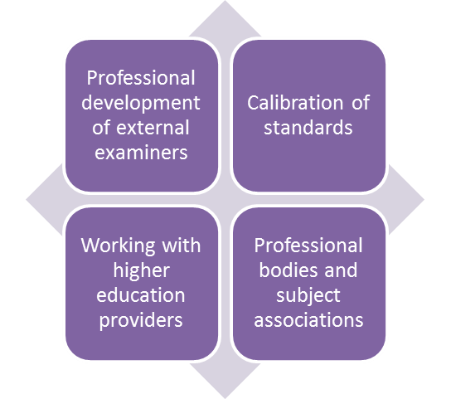
Purpose of the project
Design and pilot different approaches to the professional development of external examiners
Propose evidence-based and cost-effective longer term approaches to the professional development of external examiners
Deliver ongoing professional development for external examiners
Explore approaches to the calibration of standards and present recommendations for future work in this area
Notes:
Notes; Briefly point out that this calibration workshop has been developed as part of the four streams of work in the Degree Standards Project.
IMPORTANT: Note that the following slides are important if participants have not completed the Professional Development Course for External Examiners. If they have done the course, you only need to remind them quickly of the key message that people are a cause of variation in standards, that variation cannot be overcome by merely using documented standards as they are open to interpretation. Therefore some form of calibration of individuals understanding of standards is required. Hence the calibration activity today.

Slide 7
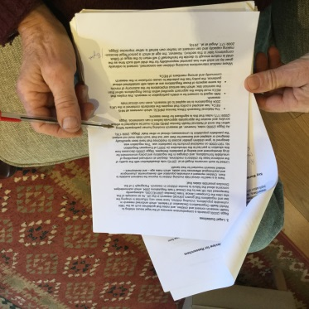
What are the academic standards?
Academic standards: output measures focusing on student achievement from written work, examinations, oral presentations, practical and fieldwork etc.
Quality standards: input and process measures focusing on all other aspects of the assessment cycle (and other resources, procedures, etc.)
Notes:
Before we look in more detail at academic standards in our own marking, it is important to be clear what we mean by ‘academic standards’. We are drawing on an approach increasingly used in the literature on quality assurance and external examining.
Academic standards are an ‘output’ measure, demonstrated in what students actually produce in their written work, examinations, performances, conduct of practical or clinical skills, etc. The academic standards for a programme are reflected in students’ actual achievements.
Quality standards are the standards we look for in the inputs and processes in higher education providers. Inputs include things like the qualifications of the staff, the library resources, the classroom environment, laboratories, student entry qualifications. Processes measured by quality standards will include activities like speed and nature of feedback on assessment, guidance to students, marking and moderation procedures, conduct of examination boards, action taken in response to evaluative material like student feedback and external examiner reports. Good quality standards are important but they do not guarantee good academic standards.
This distinction is important because external examining is often the only external quality assurance process that focuses on academic as opposed to quality standards.

Slide 8
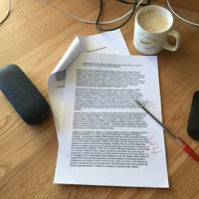
Evidence of individual differences in judging standards
Many studies, over many years, have found considerable discrepancy in the grades accorded to the same or similar student work.
Hartog and Rhodes,1935; Laming et al.,1990; Wolf, 1995; Leach, Neutze and Zepke, 2001; Elander and Hardman, 2002; Newstead, 2002; Baume, Yorke and Coffey, 2004; Norton, 2004; Hanlon et al., 2004; Read et al., 2005; Price, 2005; Shay, 2004 and 2005; Brooks, 2012; O’Hagan and Wigglesworth, 2014; Bloxham et al., 2015 (this list is not exhaustive)
Notes:
There is considerable evidence that academics hold different academic standards. Despite many lecturers claiming that they find their marks are similar to their colleagues, almost always when this has been tested in controlled circumstances, the opposite is true and considerable discrepancy has been found where marking has been truly blind. Studies over many years have repeated these findings.
It may be that people working closely together do find their marks converge which is probably the result of the mutual agreement about standards which can arise through working and talking together – an informal calibration. However, this is unlikely to be the case where tutors work in different institutions.

Slide 9
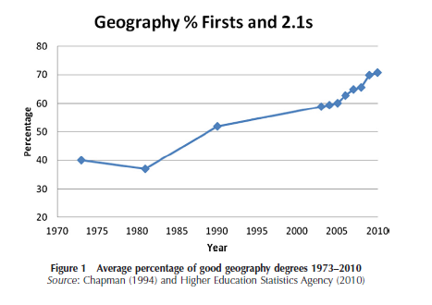
Variation in geographers’ marking
The percentage of ‘good’ (1st or 2.1) geography degrees in the UK has risen from around 40% in the early 1970s to 71% in 2010 (Thornes, 2012) and approx. 80% in 2016 (RGS-IBG, unpublished data).
In this context, it is important for geography assessors and external examiners to understand and consistently apply academic standards to ensure comparability of UK geography awards.
Do we have comparability of standards across geography assessment – or is judgement in grading variable?
Notes:
Notes: Use text on slide

Slide 10
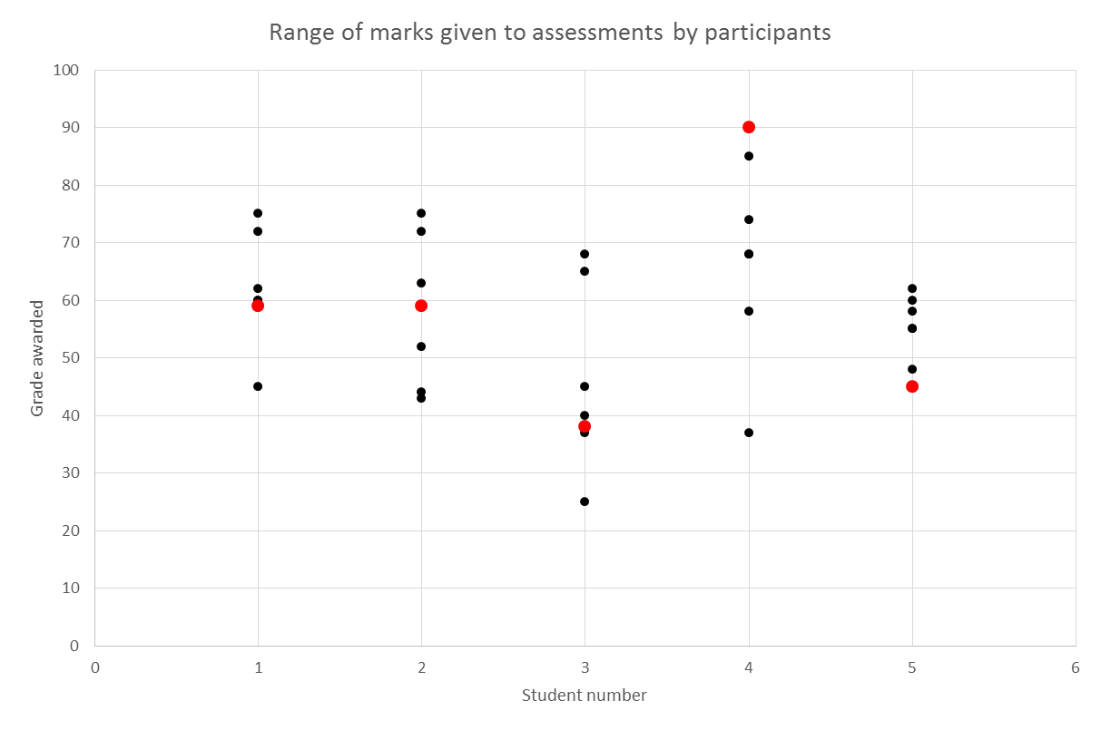
Experienced external examiners: 2017 study
Institution grade
Participant grade
Student 1 (Climate flood risk) | Student 2 (Climate & sea ice) | Student 3 (Gender and ICT) | Student 4 (Celebrity & dev’t) | Student 5 (Slum dev’t)
Notes:
Notes: These are the marks given to 5 assignments by other Geography academics and external examiners. You can see that there are strong and consistent patterns of variation in standards.

Slide 11
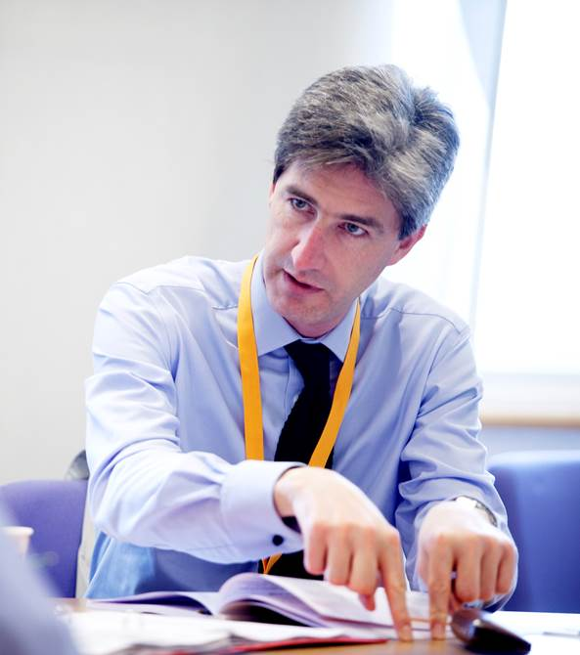
Issues in achieving consistent judgement
Variation in academic standards is common, and has implications for fairness and comparability of standards.
The main causes of variation can be categorised as
people – the differences in individuals’ experience, beliefs, expertise, habits
tools – the information and processes used to guide and quality assure assessment
tasks – the nature of assessment methods in higher education.
Notes:
It is important to recognise that this variation in standards is not a reflection of poor marking but a consequence of the nature of HE assessment. There are multiple reasons for variation which we will explore in the remainder of this week’s course. We will investigate three main reasons why such variation exists.
People: People bring with them different provenance of their standards, different experiences, influences, values, and beliefs.
Tools: Various internal and external reference points can be employed such as the framework for higher education qualifications, subject benchmarks, institutional grade descriptors, and assessment criteria. Process tools such as second marking, moderation, exam boards, and external examining can vary as well.
Tasks: The nature of assessment tasks in the UK higher education which are predominantly open-ended, constructed response tasks, where the work can be variable, unpredictable, and complex. There is a strong tradition for these types of tasks in the UK compared with many counties, such as the USA, where much more use is made of closed-ended tests such as multiple choice questions (MCQs).

Slide 12
PEOPLE: How we know our standards – tacit knowledge
Tacit knowledge is something you know that cannot be put into words
e.g. “I know a 2.i. when I see it”.
It is fundamental to expertise and judgement-making across the professions, including judgements on student work.
We learn the tacit knowledge of marking standards ‘on the job’.
We gradually become less conscious of everything we take into account when making judgements.
These create the conditions for differences in standards which we may not be aware of.
Notes:
The complexity of standards means that we draw on considerable amounts of tacit knowledge (think about all the aspects you are considering when making a judgement about a piece of work). Tacit knowledge is that which is gained from experience that, by definition, can’t be put into words. Academics may say that “I know a 2.1. when I see one”, but struggle to articulate just what it is that enables them to ‘know’ the standard. This is not surprising. Tacit knowledge has been shown to be fundamental to expertise and judgement-making in many professions. As we develop expertise, we become less conscious of everything we are taking into account when making judgements. A consequence of this is that our judgements are likely to vary to some extent as our tacit knowledge differs.
Our tacit knowledge differs because of the way in which we learn it. There is generally no formal training about marking and standards, we learn ‘on the job’ through marking, second marking, resolving marks with others and participating in moderation discussions. We learn from the advice of colleagues and mentors, what we see others doing, what we get praised for, and what we find is not so welcome. This ‘academic socialisation’ process is how we learn about marking standards (Shay, 2004; Jawitz, 2009) and the variation in it creates the conditions for the differences in standards found in research (Crisp, 2008; Broad, 2003; Hunter & Docherty, 2011)

Slide 13
TOOLS: The limitations of assessment criteria
Positive intentions
But
Academic judgement cannot be easily represented by a short set of criteria
Can’t capture tutors’ tacit knowledge
Can’t represent complexity of assessment tasks
Need interpretation of meaning, different interpretation leads to different judgement
Designed to improve consistency of
marking
Some assessors disagree with, ignore or choose not to use criteria, taking an holistic approach to judgement
Use personal criteria (e.g. effort) rather than published criteria
Use criteria they may not be aware of, e.g. font size
Staff and students positive about them
Notes:
Assessment criteria have been developed to create greater consistency and transparency and students and staff are generally positive about them.
But there is growing evidence that academic judgement cannot easily be represented by a short set of explicit criteria however carefully formulated.
We can’t write criteria which can really capture the breadth of work being assessed at higher education level – trying to quantify exactly what we mean by ‘quality of argument’ or ‘analysis’ so it not open to different interpretation is impossible. Research supports this argument that assessors interpret criteria differently resulting in different grades for students. Furthermore, assessors draw on tacit knowledge in marking which cannot, by definition, be expressed through assessment criteria.
Some of the limitations of assessment criteria are related to how they are (and aren’t) used by assessors. Studies of marking reveal limited reference to assessment criteria in practice. Academics tend to use a much more holistic approach where different criteria overlap and other factors are taken into account. In addition, research indicates that assessors may disagree agree with, ignore or choose not to adopt the published criteria. They use personal criteria beyond or different from those stated including implicit criteria they may not actually be aware of such as font size (two studies have found students are awarded on average one degree classification higher for writing in a larger font).
Overall, this body of research suggest that assessment criteria are not the solution to assuring marking standards that many think them to be.

Slide 14
TASKS: Open-ended tasks
Assessment tasks (e.g. essays and dissertations) which generate responses from students are
varying
complex
unpredictable
sometimes personalised.
Higher order and complex performance necessarily involves work with these characteristics.
It is unfeasible to precisely document marking schemes.
Marking relies on judgement.
Notes:
A third cause of variation in marks is the use of open-ended complex tasks which are very typical in UK higher education.
We value this type of task as more appropriate for assessing high level performance than closed tasks such as MCQs.
These tasks can generate diverse, complex, unpredictable and sometimes quite personalised responses from students.
Applying assessment criteria reliably to these types of assignments is considered nigh impossible because it is unfeasible to precisely document everything that might need to be taken into account. We have to achieve a balance between utility and accuracy. To make tools practical, we need to limit the detail but limited detail means they are open to different interpretation.
We will now carry out a task to consider the application of these tools in external examining – go to next slide after the task description.

Slide 15
Implication: Need for calibration
We cannot rely either on written standards or on our informal learning about standards to ensure that we share standards with the rest of our subject community.
“Consistent assessment decisions among assessors are the product of interactions over time, the internalisation of exemplars, and of inclusive networks. Written instructions, mark schemes and criteria, even when used with scrupulous care, cannot substitute for these.” (HEQC, 1997)
Notes:
A key implication of this is that people examiners are one key source of variation in standards but we cannot assume that providing statements of standards will overcome this difficulty because of the difficulty of writing down tacit knowledge.
20 years ago, the forerunner of the QAA, the HEQC, identified the need for interactions, exemplars and networks to help create consistent assessment decisions.
There are insufficient opportunities for academics, particularly external examiners, to calibrate their standards and that is the reason for today’s calibration workshop.

Slide 16
Social moderation to calibration
Social moderation involves discussion of grading, but is generally focused on agreeing marks.
Calibration is about shared knowledge of standards, often achieved through social moderation processes in order to create ‘calibrated’ academics.
‘calibrated’ academics … are able to make grading judgements consistent with those which similarly calibrated colleagues would make, but without constant engagement in moderation. The overall aims are to achieve comparability of standards across institutions and stability of standards over time (Sadler, 2012)
Notes:
Notes: Use text on slide to distinguish between the type of social moderation process that takes place in order to resolve marks after the work has been submitted. These are often internal processes. This contrasts with ‘Calibration’ which is a process to help develop consistency of standards before judgement takes place. It often involves assessors from different institutions to achieve greater confidence in standards across different programmes.
The last section is a quotation from Royce Sadler defining a ‘calibrated’ academic.

Slide 17
Running calibration – one assignment at a time
STAGE 1 – Individual and online
You marked three final-year coursework assignments drawing on your knowledge of appropriate standards.
You submitted your marks and your comments.
These are the baseline data for our calibration exercise today – they tell us how much variation we have in standards.
STAGE 2 – Small group
Starting with Assignment 1
discuss your views and try to arrive at a consensus regarding the mark
note on the ‘group’ sheet your agreed mark and the characteristics of the assignment that most influenced your decision, particularly at the borderlines: pass/fail, 2.2./2.1, 2.1/1st
be prepared to share.
STAGE 3 – Whole group
We will share the small-group judgements and try to derive a consensus, making the case for our viewpoints where they differ.
We will try to assemble a list of the common characteristics of the three assignments which influenced our judgement – i.e. making explicit our standards.
Notes:
Notes: Use this to explain the detail of the calibration process. Note that stage 1 has already been completed on line.

Slide 18
Add mark range, mode & mean for each assignment
Marker | Assignment 1 | Assignment 2 | Assignment 3
1
2
3
4
5
6
7
8
Range
Mode
Mean
Notes:
You may replace this by just having the range of marks for each assignment so as not to over-influence the discussion in the small groups which might occur if they know what the mean mark is.

Slide 19
Conclusion
Social processes are the most effective for assuring academic standards (social moderation / consensus moderation).
This calibration exercise can be used profitably within institutions, faculties, departments and programme teams to improve consistency of standards.
Notes:
Use the text on the slide.

