Slide 1
Calibrating Academic Standards in Geography

Slide 2
Aims
To raise awareness among geography academics and examiners of the potential variation in academic standards across different assessors
To use dialogue to build greater consistency in the judgement of student work among geography lecturers and examiners, within and across programmes and institutions
To discuss and create a shared understanding of criteria for the assessment of research-based coursework essays or reports, drawing on key reference documents

Slide 3
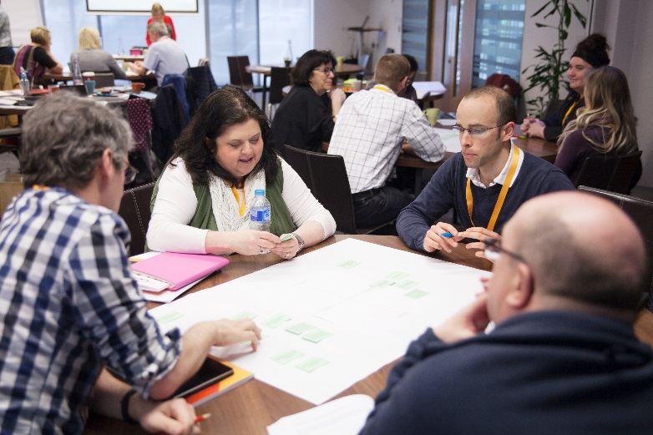
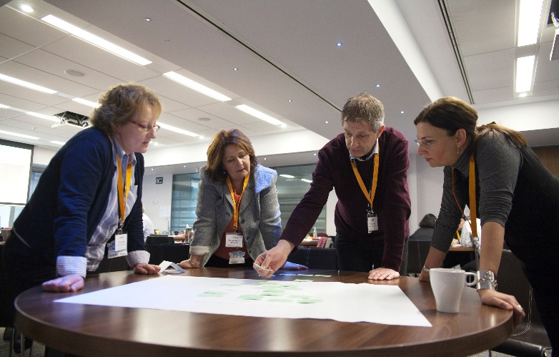
Intended outcomes
Participants will develop:
greater awareness of differences in academic standards across assessors
greater capability and confidence in drawing on accepted academic standards in their assessing and examining roles
a shared interpretation of agreed key criteria for the assessment of research-based coursework essays or reports, with reference to relevant national standards statements.

Slide 4
Format of the day
Introduction
Brief presentation of research on consistency and patterns of marking in higher education in general, and geography in particular
Calibrating our standards through attempting to achieve a consensus about the coursework examples – in small groups and then across the whole group
Developing a list of influential characteristics in student work that help to decide marks, particularly at the borderline
Adhering to the Chatham House rule

Slide 5
Policy context
‘it would be beneficial to the sector and its stakeholders to consider further modernising or professionalising the external examining system. We believe that further strengthening some aspects of the current arrangements would enhance the role of the … system as part of the future quality assessment system’
(HEFCE, 2016: Revised Operating Model for Quality Assessment p. 36)
Advance HE were awarded the contract by OfS on behalf of the devolved administrations to lead the Degree Standards project, running from 2016 to 2021.
The project, which is sector-led, aims to develop a sector-owned process of professional development for external examiners.

Slide 6
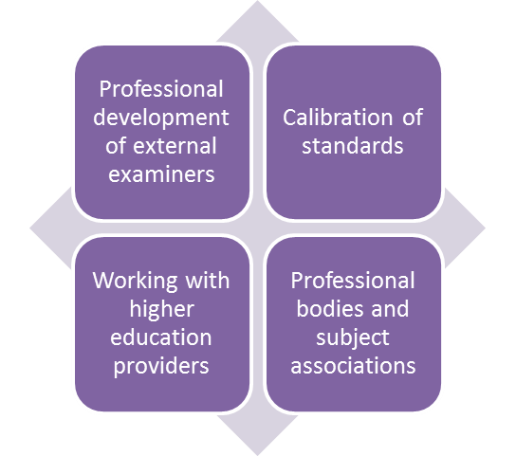
Purpose of the project
Design and pilot different approaches to the professional development of external examiners
Propose evidence-based and cost-effective longer term approaches to the professional development of external examiners
Deliver ongoing professional development for external examiners
Explore approaches to the calibration of standards and present recommendations for future work in this area

Slide 7
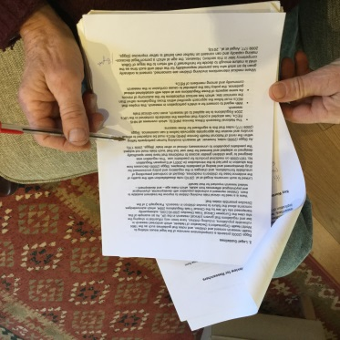
What are the academic standards?
Academic standards: output measures focusing on student achievement from written work, examinations, oral presentations, practical and fieldwork etc.
Quality standards: input and process measures focusing on all other aspects of the assessment cycle (and other resources, procedures, etc.)

Slide 8
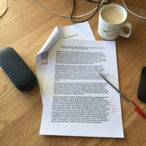
Evidence of individual differences in judging standards
Many studies, over many years, have found considerable discrepancy in the grades accorded to the same or similar student work.
Hartog and Rhodes,1935; Laming et al.,1990; Wolf, 1995; Leach, Neutze and Zepke, 2001; Elander and Hardman, 2002; Newstead, 2002; Baume, Yorke and Coffey, 2004; Norton, 2004; Hanlon et al., 2004; Read et al., 2005; Price, 2005; Shay, 2004 and 2005; Brooks, 2012; O’Hagan and Wigglesworth, 2014; Bloxham et al., 2015 (this list is not exhaustive)

Slide 9
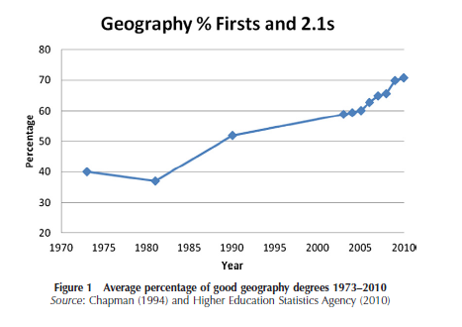
Variation in geographers’ marking
The percentage of ‘good’ (1st or 2.1) geography degrees in the UK has risen from around 40% in the early 1970s to 71% in 2010 (Thornes, 2012) and approx. 80% in 2016 (RGS-IBG, unpublished data).
In this context, it is important for geography assessors and external examiners to understand and consistently apply academic standards to ensure comparability of UK geography awards.
Do we have comparability of standards across geography assessment – or is judgement in grading variable?

Slide 10
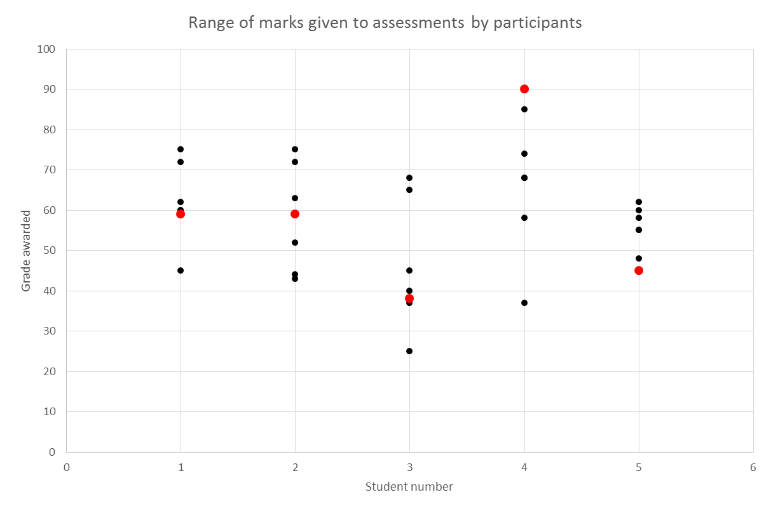
Experienced external examiners: 2017 study
Institution grade
Participant grade
Student 1 (Climate flood risk) | Student 2 (Climate & sea ice) | Student 3 (Gender and ICT) | Student 4 (Celebrity & dev’t) | Student 5 (Slum dev’t)

Slide 11
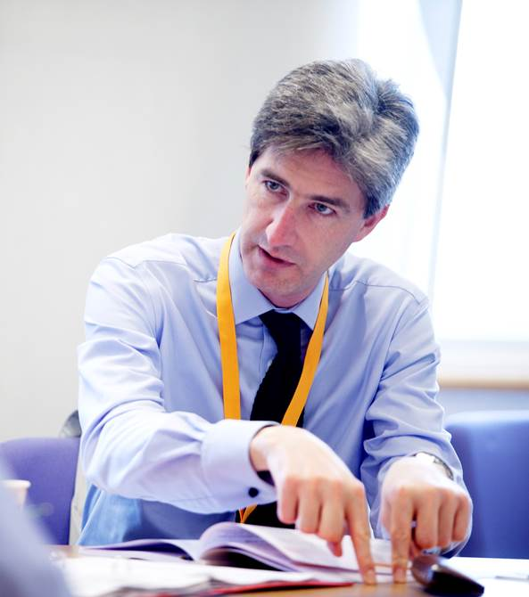
Issues in achieving consistent judgement
Variation in academic standards is common, and has implications for fairness and comparability of standards.
The main causes of variation can be categorised as
people – the differences in individuals’ experience, beliefs, expertise, habits
tools – the information and processes used to guide and quality assure assessment
tasks – the nature of assessment methods in higher education.

Slide 12
PEOPLE: How we know our standards – tacit knowledge
Tacit knowledge is something you know that cannot be put into words
e.g. “I know a 2.i. when I see it”.
It is fundamental to expertise and judgement-making across the professions, including judgements on student work.
We learn the tacit knowledge of marking standards ‘on the job’.
We gradually become less conscious of everything we take into account when making judgements.
These create the conditions for differences in standards which we may not be aware of.

Slide 13
TOOLS: The limitations of assessment criteria
Positive intentions
But
Academic judgement cannot be easily represented by a short set of criteria
Can’t capture tutors’ tacit knowledge
Can’t represent complexity of assessment tasks
Need interpretation of meaning, different interpretation leads to different judgement
Designed to improve consistency of
marking
Some assessors disagree with, ignore or choose not to use criteria, taking an holistic approach to judgement
Use personal criteria (e.g. effort) rather than published criteria
Use criteria they may not be aware of, e.g. font size
Staff and students positive about them

Slide 14
TASKS: Open-ended tasks
Assessment tasks (e.g. essays and dissertations) which generate responses from students are
varying
complex
unpredictable
sometimes personalised.
Higher order and complex performance necessarily involves work with these characteristics.
It is unfeasible to precisely document marking schemes.
Marking relies on judgement.

Slide 15
Implication: Need for calibration
We cannot rely either on written standards or on our informal learning about standards to ensure that we share standards with the rest of our subject community.
“Consistent assessment decisions among assessors are the product of interactions over time, the internalisation of exemplars, and of inclusive networks. Written instructions, mark schemes and criteria, even when used with scrupulous care, cannot substitute for these.” (HEQC, 1997)

Slide 16
Social moderation to calibration
Social moderation involves discussion of grading, but is generally focused on agreeing marks.
Calibration is about shared knowledge of standards, often achieved through social moderation processes in order to create ‘calibrated’ academics.
‘calibrated’ academics … are able to make grading judgements consistent with those which similarly calibrated colleagues would make, but without constant engagement in moderation. The overall aims are to achieve comparability of standards across institutions and stability of standards over time (Sadler, 2012)

Slide 17
Running calibration – one assignment at a time
STAGE 1 – Individual and online
You marked three final-year coursework assignments drawing on your knowledge of appropriate standards.
You submitted your marks and your comments.
These are the baseline data for our calibration exercise today – they tell us how much variation we have in standards.
STAGE 2 – Small group
Starting with Assignment 1
discuss your views and try to arrive at a consensus regarding the mark
note on the ‘group’ sheet your agreed mark and the characteristics of the assignment that most influenced your decision, particularly at the borderlines: pass/fail, 2.2./2.1, 2.1/1st
be prepared to share.
STAGE 3 – Whole group
We will share the small-group judgements and try to derive a consensus, making the case for our viewpoints where they differ.
We will try to assemble a list of the common characteristics of the three assignments which influenced our judgement – i.e. making explicit our standards.

Slide 18
Add mark range, mode & mean for each assignment
Marker | Assignment 1 | Assignment 2 | Assignment 3
1
2
3
4
5
6
7
8
Range
Mode
Mean

Slide 19
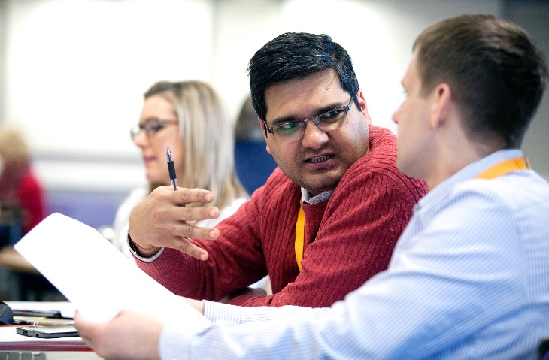
Conclusion
Social processes are the most effective for assuring academic standards (social moderation / consensus moderation).
This calibration exercise can be used profitably within institutions, faculties, departments and programme teams to improve consistency of standards.

